Slide 1
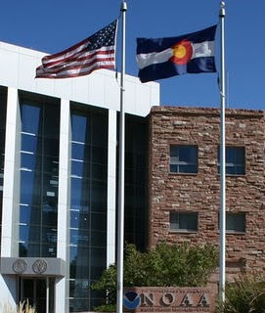
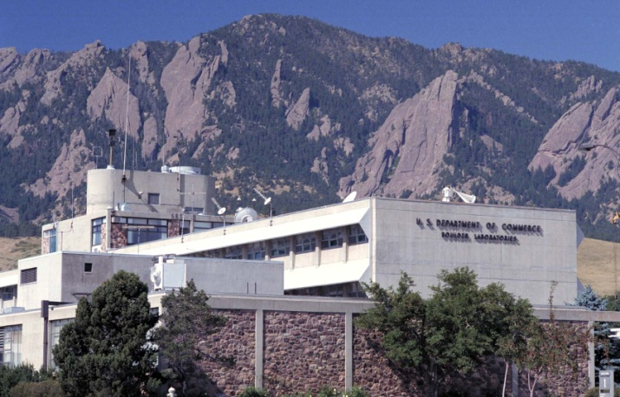
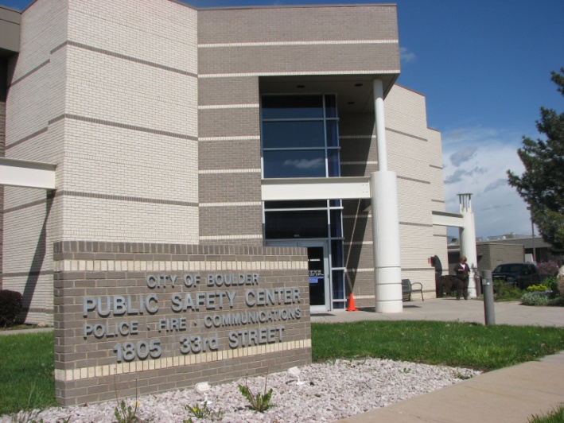
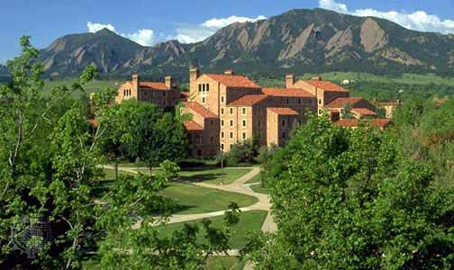
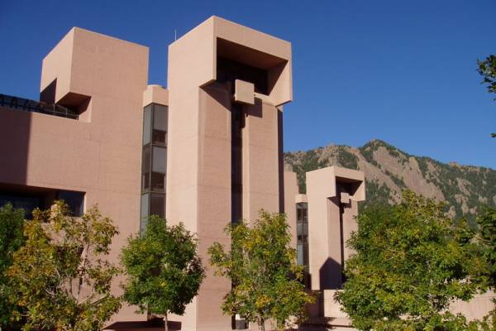
BRAN In Action
NIST
o 1 fiber strand that takes a circuitous route across BRAN to create a large loop for a NIST clocking testbed
o NIST and CU-JILA for optical experiments (no longer in use)
NOAA - Boulder
o CU and Level 3 Primary connection - 1GE
o CU Backup - 1GE
o FRGP Primary - 10GE
o FRGP Backup - 2x1GE
o NCAR Backup - 1GE
o NLR FrameNet - 10GE
o GSD loop - 10GE (no longer in use)
o NOAA-NCAR DWDM testbed - 10G + 2.5G lambdas (now down to one 2.5G lambda)
City of Boulder
o Atrium Building to Public Safety Building (1 pair, 1 Gbps)
o Municipal Building to Public Safety Building via Atrium Building (1 pair, 10 Gbps)
o Municipal Building to George Reynolds Branch Library via Atrium Building (1 pair, 1 Gbps)
o Public Safety Building to CU Telecom for BPoP/UPoP Internet connection and Boulder County Longmont connection (3 pair, 3 Gbps)
o Children/Youth/Families Building to Municipal Building via Atrium Building (1 pair, 1 Gbps)
o Iris Center to Municipal Building via Atrium Building (1 pair, 1 Gbps)
o Public Safety Building to Yards (1 pair, 10 Gbps)
o Public Safety Building to Boulder County Communications Center via Yards (1 pair, 10 Gbps)
o 75th St Wastewater Treatment Plant to Yards via UCAR FL (1 pair, 1 Gbps)
o Fire Station 6 to Yards via UCAR FL (1 pair, 1 Gbps)
o Fire Station 5 to Yards via UCAR FL (1 pair, 1 Gbps)
o UCAR FL to Boulder County Communications Center for use by Boulder County for BVSD fiber connection (2 pair, 20 Gbps)
University of Colorado - Boulder
o Expo - G-net, PBX, CONN, G-net, G-net
o CUPD - CUPD to BPD
o UMS - PBX, ATM, PBX, ATM, (6) CONN, G-net
o ENG - PBX, (19) CONN, PBX
o Three pairs for campus telephones at UMS (150 Mbps per pair)
o One pair for Ethernet service at CINC (1777 Exposition)
o One pair for Ethernet service at IBSX (the Reynolds bldg) (1Gbps)
o One pair for Ethernet service at the CU-Foundation (1Gbps)
o One pair for connection to Level 3/ICG in Boulder (1Gbps)
o One pair for test connection to NCAR (10 Gbps)
o Three pairs for MRI connection to campus and NCAR (10 Gbps) (in June)
o One pair for connection to NCAR (1 Gbps)
o One pair for connection to NOAA/NIST (1 Gbps)
o One pair to connect CUPD to BRESTA (1 Gbps)
National Center for Atmospheric Research
o ML TeraGrid 10GigE
o FL2-TCOM 10GigE
o ML-L3B T1 MUX Ring (West)
o ML-L3B T1 MUX Ring (East from Red 3,4)
o ML-FL (SaSS)
o ML-CG GigE
o MLR(B)-FLR(B) GigE
o ML-L3B T1 MUX Ring (East to White 3,4)
o MLR(A)-FLR(A) GigE
o MLR(A)-FLR(A) 10 GigE
o ML-TCOM 10GigE
o TCOM -UNCAVCO 1G
o Boulder-Longmont (BiSON) 2.5 Gig
o Boulder-Denver (BiSON) 2.5 Gig

Slide 2
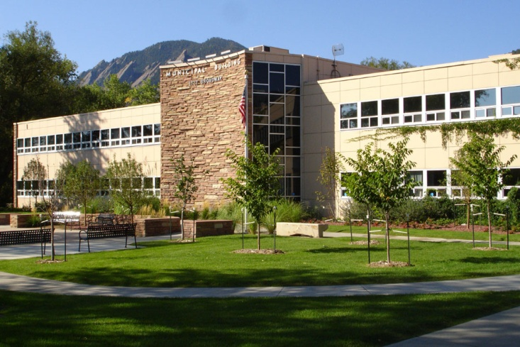
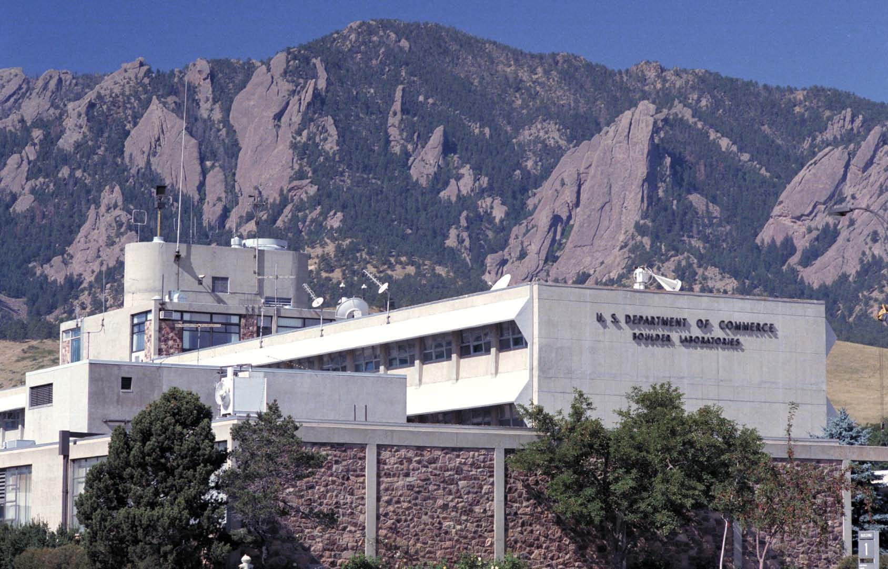
BRAN In Action
NIST
o 1 fiber strand that takes a circuitous route across BRAN to create a large loop for a NIST clocking testbed
o NIST and CU-JILA for optical experiments (no longer in use)
NOAA - Boulder
o CU and Level 3 Primary connection - 1GE
o CU Backup - 1GE
o FRGP Primary - 10GE
o FRGP Backup - 2x1GE
o NCAR Backup - 1GE
o NLR FrameNet - 10GE
o GSD loop - 10GE (no longer in use)
o NOAA-NCAR DWDM testbed - 10G + 2.5G lambdas (now down to one 2.5G lambda)
City of Boulder
o Atrium Building to Public Safety Building (1 pair, 1 Gbps)
o Municipal Building to Public Safety Building via Atrium Building (1 pair, 10 Gbps)
o Municipal Building to George Reynolds Branch Library via Atrium Building (1 pair, 1 Gbps)
o Public Safety Building to CU Telecom for BPoP/UPoP Internet connection and Boulder County Longmont connection (3 pair, 3 Gbps)
o Children/Youth/Families Building to Municipal Building via Atrium Building (1 pair, 1 Gbps)
o Iris Center to Municipal Building via Atrium Building (1 pair, 1 Gbps)
o Public Safety Building to Yards (1 pair, 10 Gbps)
o Public Safety Building to Boulder County Communications Center via Yards (1 pair, 10 Gbps)
o 75th St Wastewater Treatment Plant to Yards via UCAR FL (1 pair, 1 Gbps)
o Fire Station 6 to Yards via UCAR FL (1 pair, 1 Gbps)
o Fire Station 5 to Yards via UCAR FL (1 pair, 1 Gbps)
o UCAR FL to Boulder County Communications Center for use by Boulder County for BVSD fiber connection (2 pair, 20 Gbps)
University of Colorado - Boulder
o Expo - G-net, PBX, CONN, G-net, G-net
o CUPD - CUPD to BPD
o UMS - PBX, ATM, PBX, ATM, (6) CONN, G-net
o ENG - PBX, (19) CONN, PBX
o Three pairs for campus telephones at UMS (150 Mbps per pair)
o One pair for Ethernet service at CINC (1777 Exposition)
o One pair for Ethernet service at IBSX ( the Reynolds bldg) (1Gbps)
o One pair for Ethernet service at the CU-Foundation (1Gbps)
o One pair for connection to Level3/ICG in Boulder (1Gbps)
o One pair for test connection to NCAR (10 Gbps)
o Three pairs for MRI connection to campus and NCAR (10 Gbps) (in June)
o One pair for connection to NCAR (1 Gbps)
o One pair for connection to NOAA/NIST (1 Gbps)
o One pair to connect CUPD to BRESTA (1 Gbps)
National Center for Atmospheric Research
o ML TeraGrid 10GigE
o FL2-TCOM 10GigE
o ML-L3B T1 MUX Ring (West)
o ML-L3B T1 MUX Ring (East from Red 3,4)
o ML-FL (SaSS)
o ML-CG GigE
o MLR(B)-FLR(B) GigE
o ML-L3B T1 MUX Ring (East to White 3,4)
o MLR(A)-FLR(A) GigE
o MLR(A)-FLR(A) 10 GigE
o ML-TCOM 10GigE
o TCOM -UNCAVCO 1G
o Boulder-Longmont (BiSON) 2.5 Gig
o Boulder-Denver (BiSON) 2.5 Gig

Slide 3
BRAN In Action
NIST
o 1 fiber strand that takes a circuitous route across BRAN to create a large loop for a NIST clocking testbed
o NIST and CU-JILA for optical experiments (no longer in use)
NOAA - Boulder
o CU and Level 3 Primary connection - 1GE
o CU Backup - 1GE
o FRGP Primary - 10GE
o FRGP Backup - 2x1GE
o NCAR Backup - 1GE
o NLR FrameNet - 10GE
o GSD loop - 10GE (no longer in use)
o NOAA-NCAR DWDM testbed - 10G + 2.5G lambdas (now down to one 2.5G lambda)
City of Boulder
o Atrium Building to Public Safety Building (1 pair, 1 Gbps)
o Municipal Building to Public Safety Building via Atrium Building (1 pair, 10 Gbps)
o Municipal Building to George Reynolds Branch Library via Atrium Building (1 pair, 1 Gbps)
o Public Safety Building to CU Telecom for BPoP/UPoP Internet connection and Boulder County Longmont connection (3 pair, 3 Gbps)
o Children/Youth/Families Building to Municipal Building via Atrium Building (1 pair, 1 Gbps)
o Iris Center to Municipal Building via Atrium Building (1 pair, 1 Gbps)
o Public Safety Building to Yards (1 pair, 10 Gbps)
o Public Safety Building to Boulder County Communications Center via Yards (1 pair, 10 Gbps)
o 75th St Wastewater Treatment Plant to Yards via UCAR FL (1 pair, 1 Gbps)
o Fire Station 6 to Yards via UCAR FL (1 pair, 1 Gbps)
o Fire Station 5 to Yards via UCAR FL (1 pair, 1 Gbps)
o UCAR FL to Boulder County Communications Center for use by Boulder County for BVSD fiber connection (2 pair, 20 Gbps)
University of Colorado - Boulder
o Expo - G-net, PBX, CONN, G-net, G-net
o CUPD - CUPD to BPD
o UMS - PBX, ATM, PBX, ATM, (6) CONN, G-net
o ENG - PBX, (19) CONN, PBX
o Three pairs for campus telephones at UMS (150 Mbps per pair)
o One pair for Ethernet service at CINC (1777 Exposition)
o One pair for Ethernet service at IBSX ( the Reynolds bldg) (1Gbps)
o One pair for Ethernet service at the CU-Foundation (1Gbps)
o One pair for connection to Level3/ICG in Boulder (1Gbps)
o One pair for test connection to NCAR (10 Gbps)
o Three pairs for MRI connection to campus and NCAR (10 Gbps) (in June)
o One pair for connection to NCAR (1 Gbps)
o One pair for connection to NOAA/NIST (1 Gbps)
o One pair to connect CUPD to BRESTA (1 Gbps)
National Center for Atmospheric Research
o ML TeraGrid 10GigE
o FL2-TCOM 10GigE
o ML-L3B T1 MUX Ring (West)
o ML-L3B T1 MUX Ring (East from Red 3,4)
o ML-FL (SaSS)
o ML-CG GigE
o MLR(B)-FLR(B) GigE
o ML-L3B T1 MUX Ring (East to White 3,4)
o MLR(A)-FLR(A) GigE
o MLR(A)-FLR(A) 10 GigE
o ML-TCOM 10GigE
o TCOM -UNCAVCO 1G
o Boulder-Longmont (BiSON) 2.5 Gig
o Boulder-Denver (BiSON) 2.5 Gig

Slide 4
BRAN 10TH ANNIVERSARY EVENT - 05/14/10
NAME | AFFILIATION

